Slide 1
Rain

Slide 2
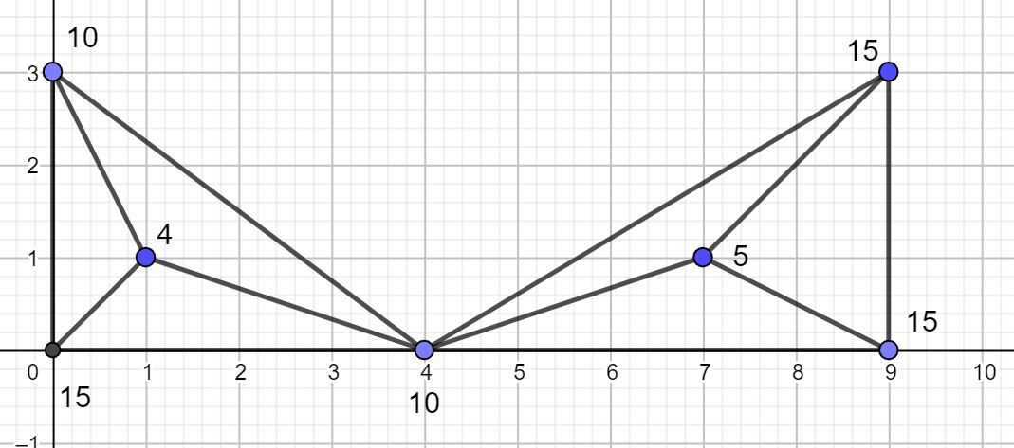
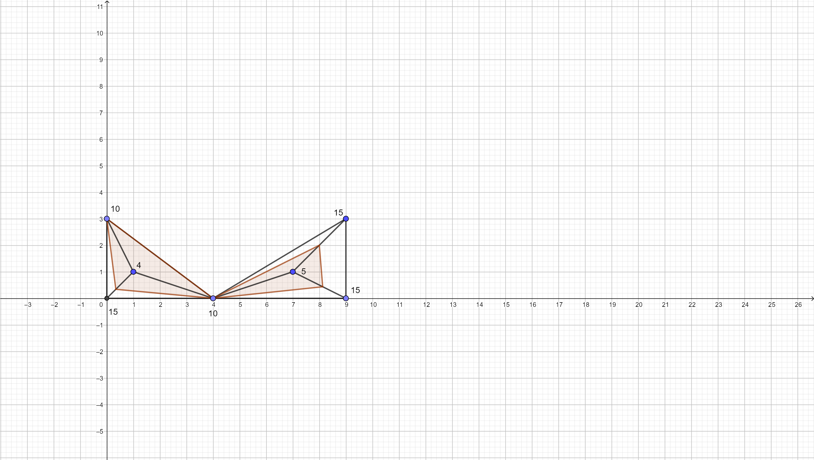
題目敘述
我們有一張地形圖，地形圖是一張graph，graph中每一個node有x座標(x),y座標(y),跟他們的高度(h)，node之間被edge連接起來，連接的方式被稱為三角化，一言以蔽之就是圖形上所有的edge都會呈三角形。
今天突然下了一場大暴雨，把所有地形上的
凹口都填成了湖，我們的任務是輸出所有湖
的水平高度。
輸出:
Case num:
10
10

Slide 3
Testcase restrictions
1. No intersections
2.Single connected region
3.No “holes”

Slide 4
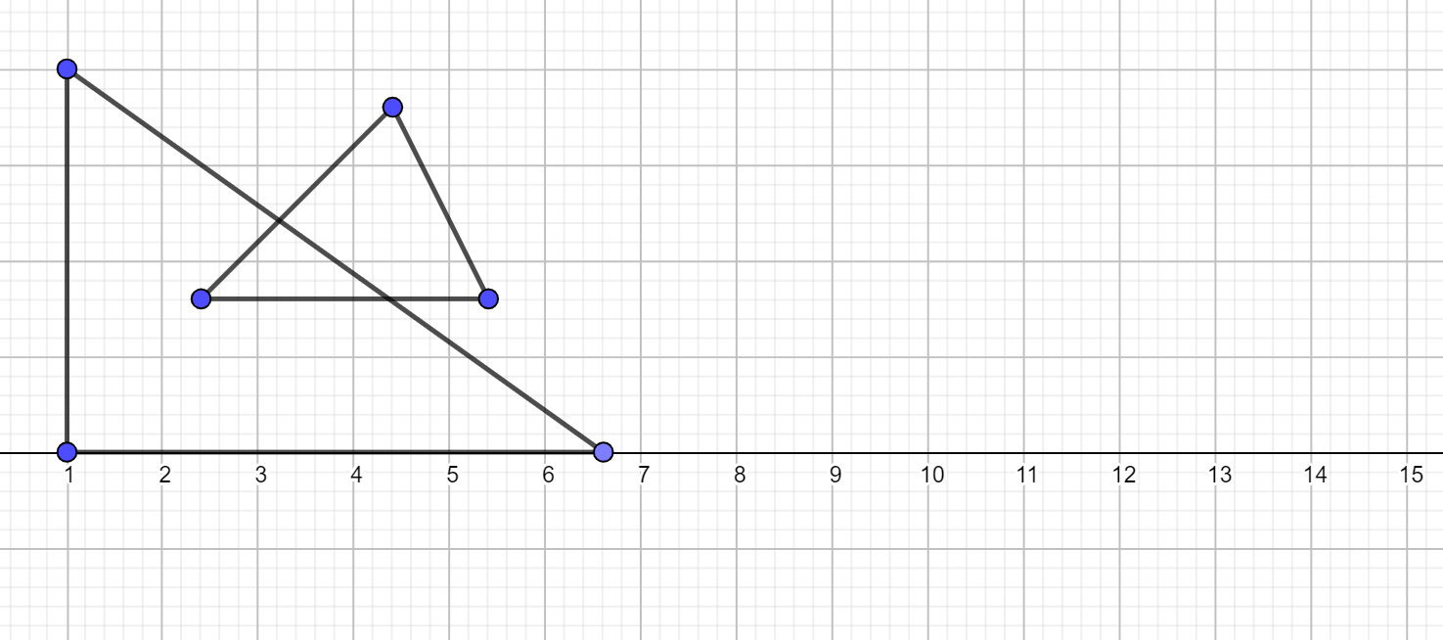
No intersections
Edges should not intersect each other except for end points

Slide 5
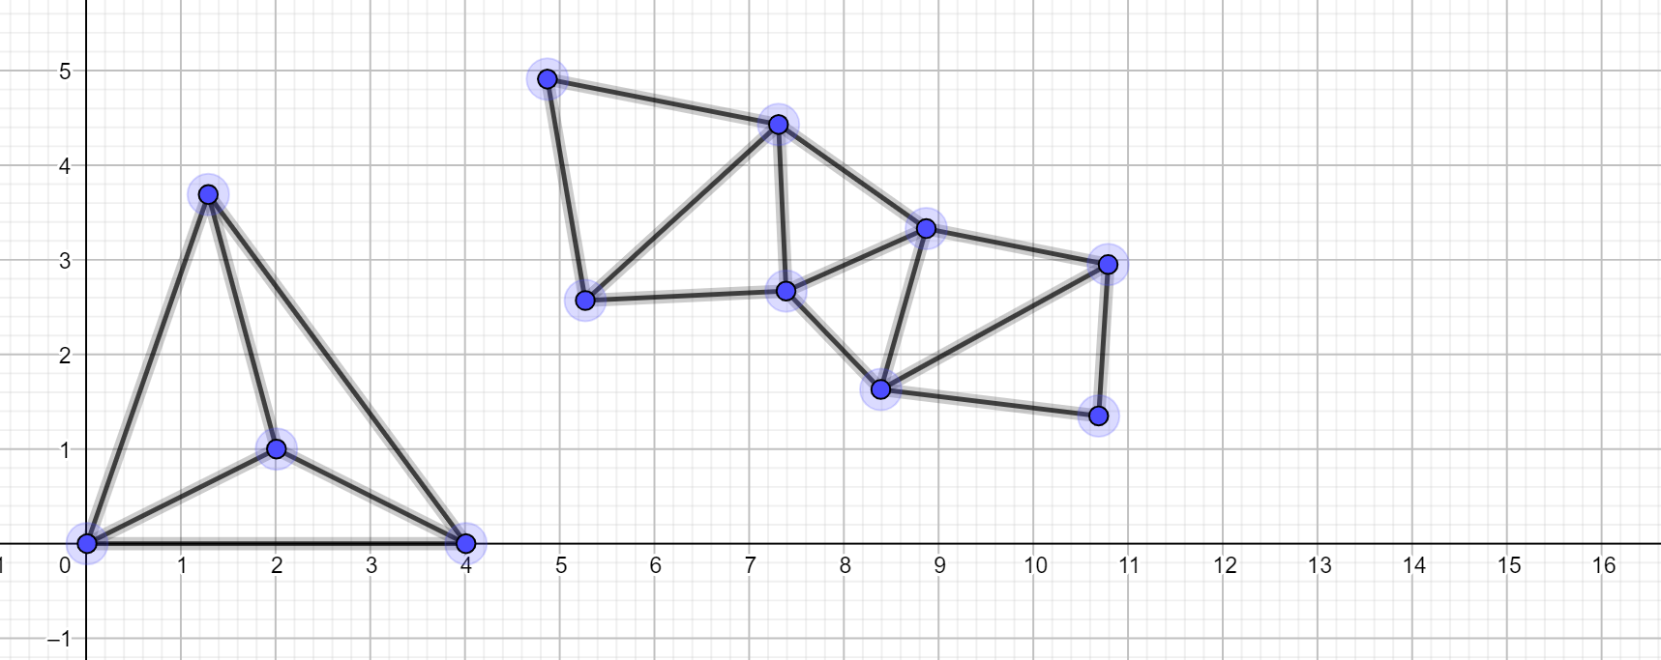
Single connected region
Points and edges form a single connected region

Slide 6
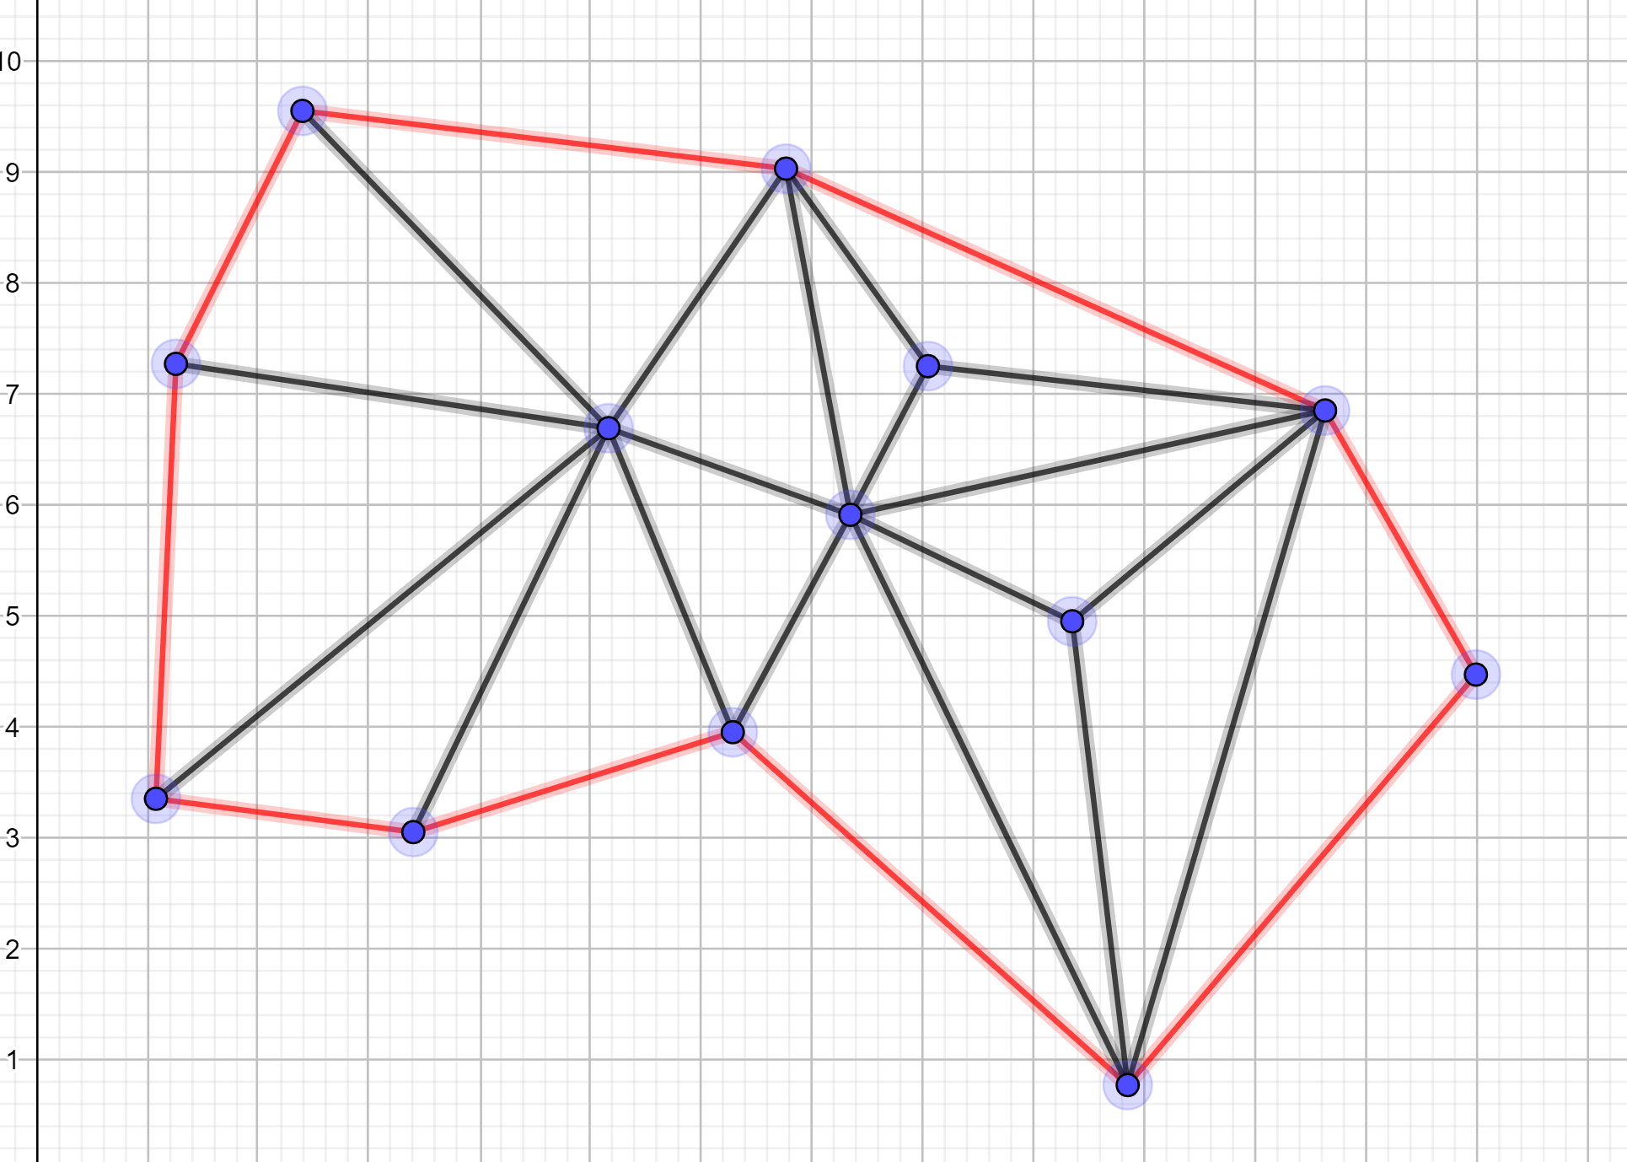
boundary
定義:任何一個edge，沒有被兩個三角形所包含即為一個boundary。

Slide 7
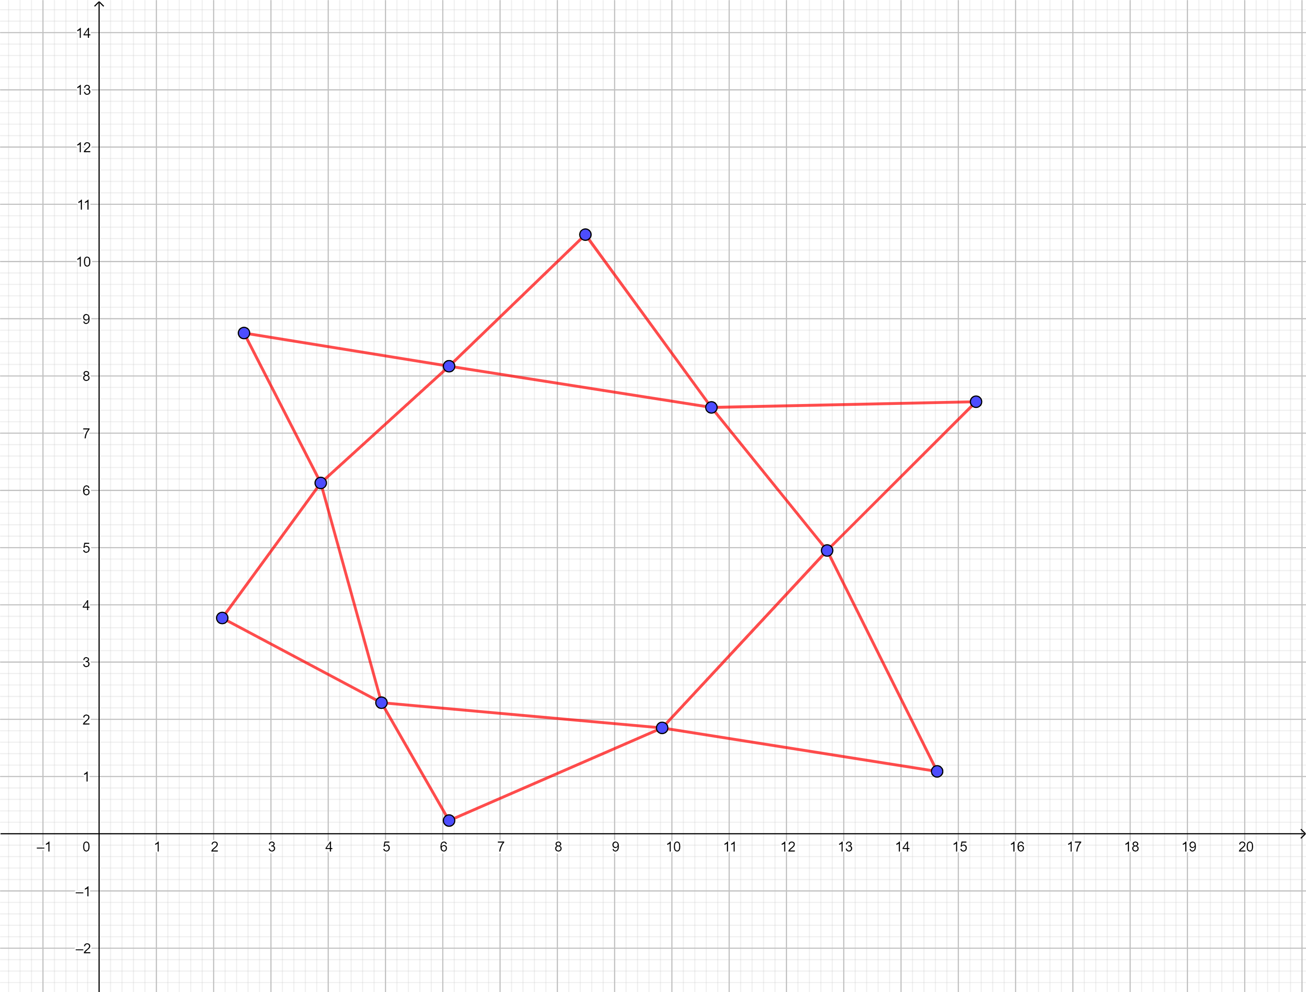
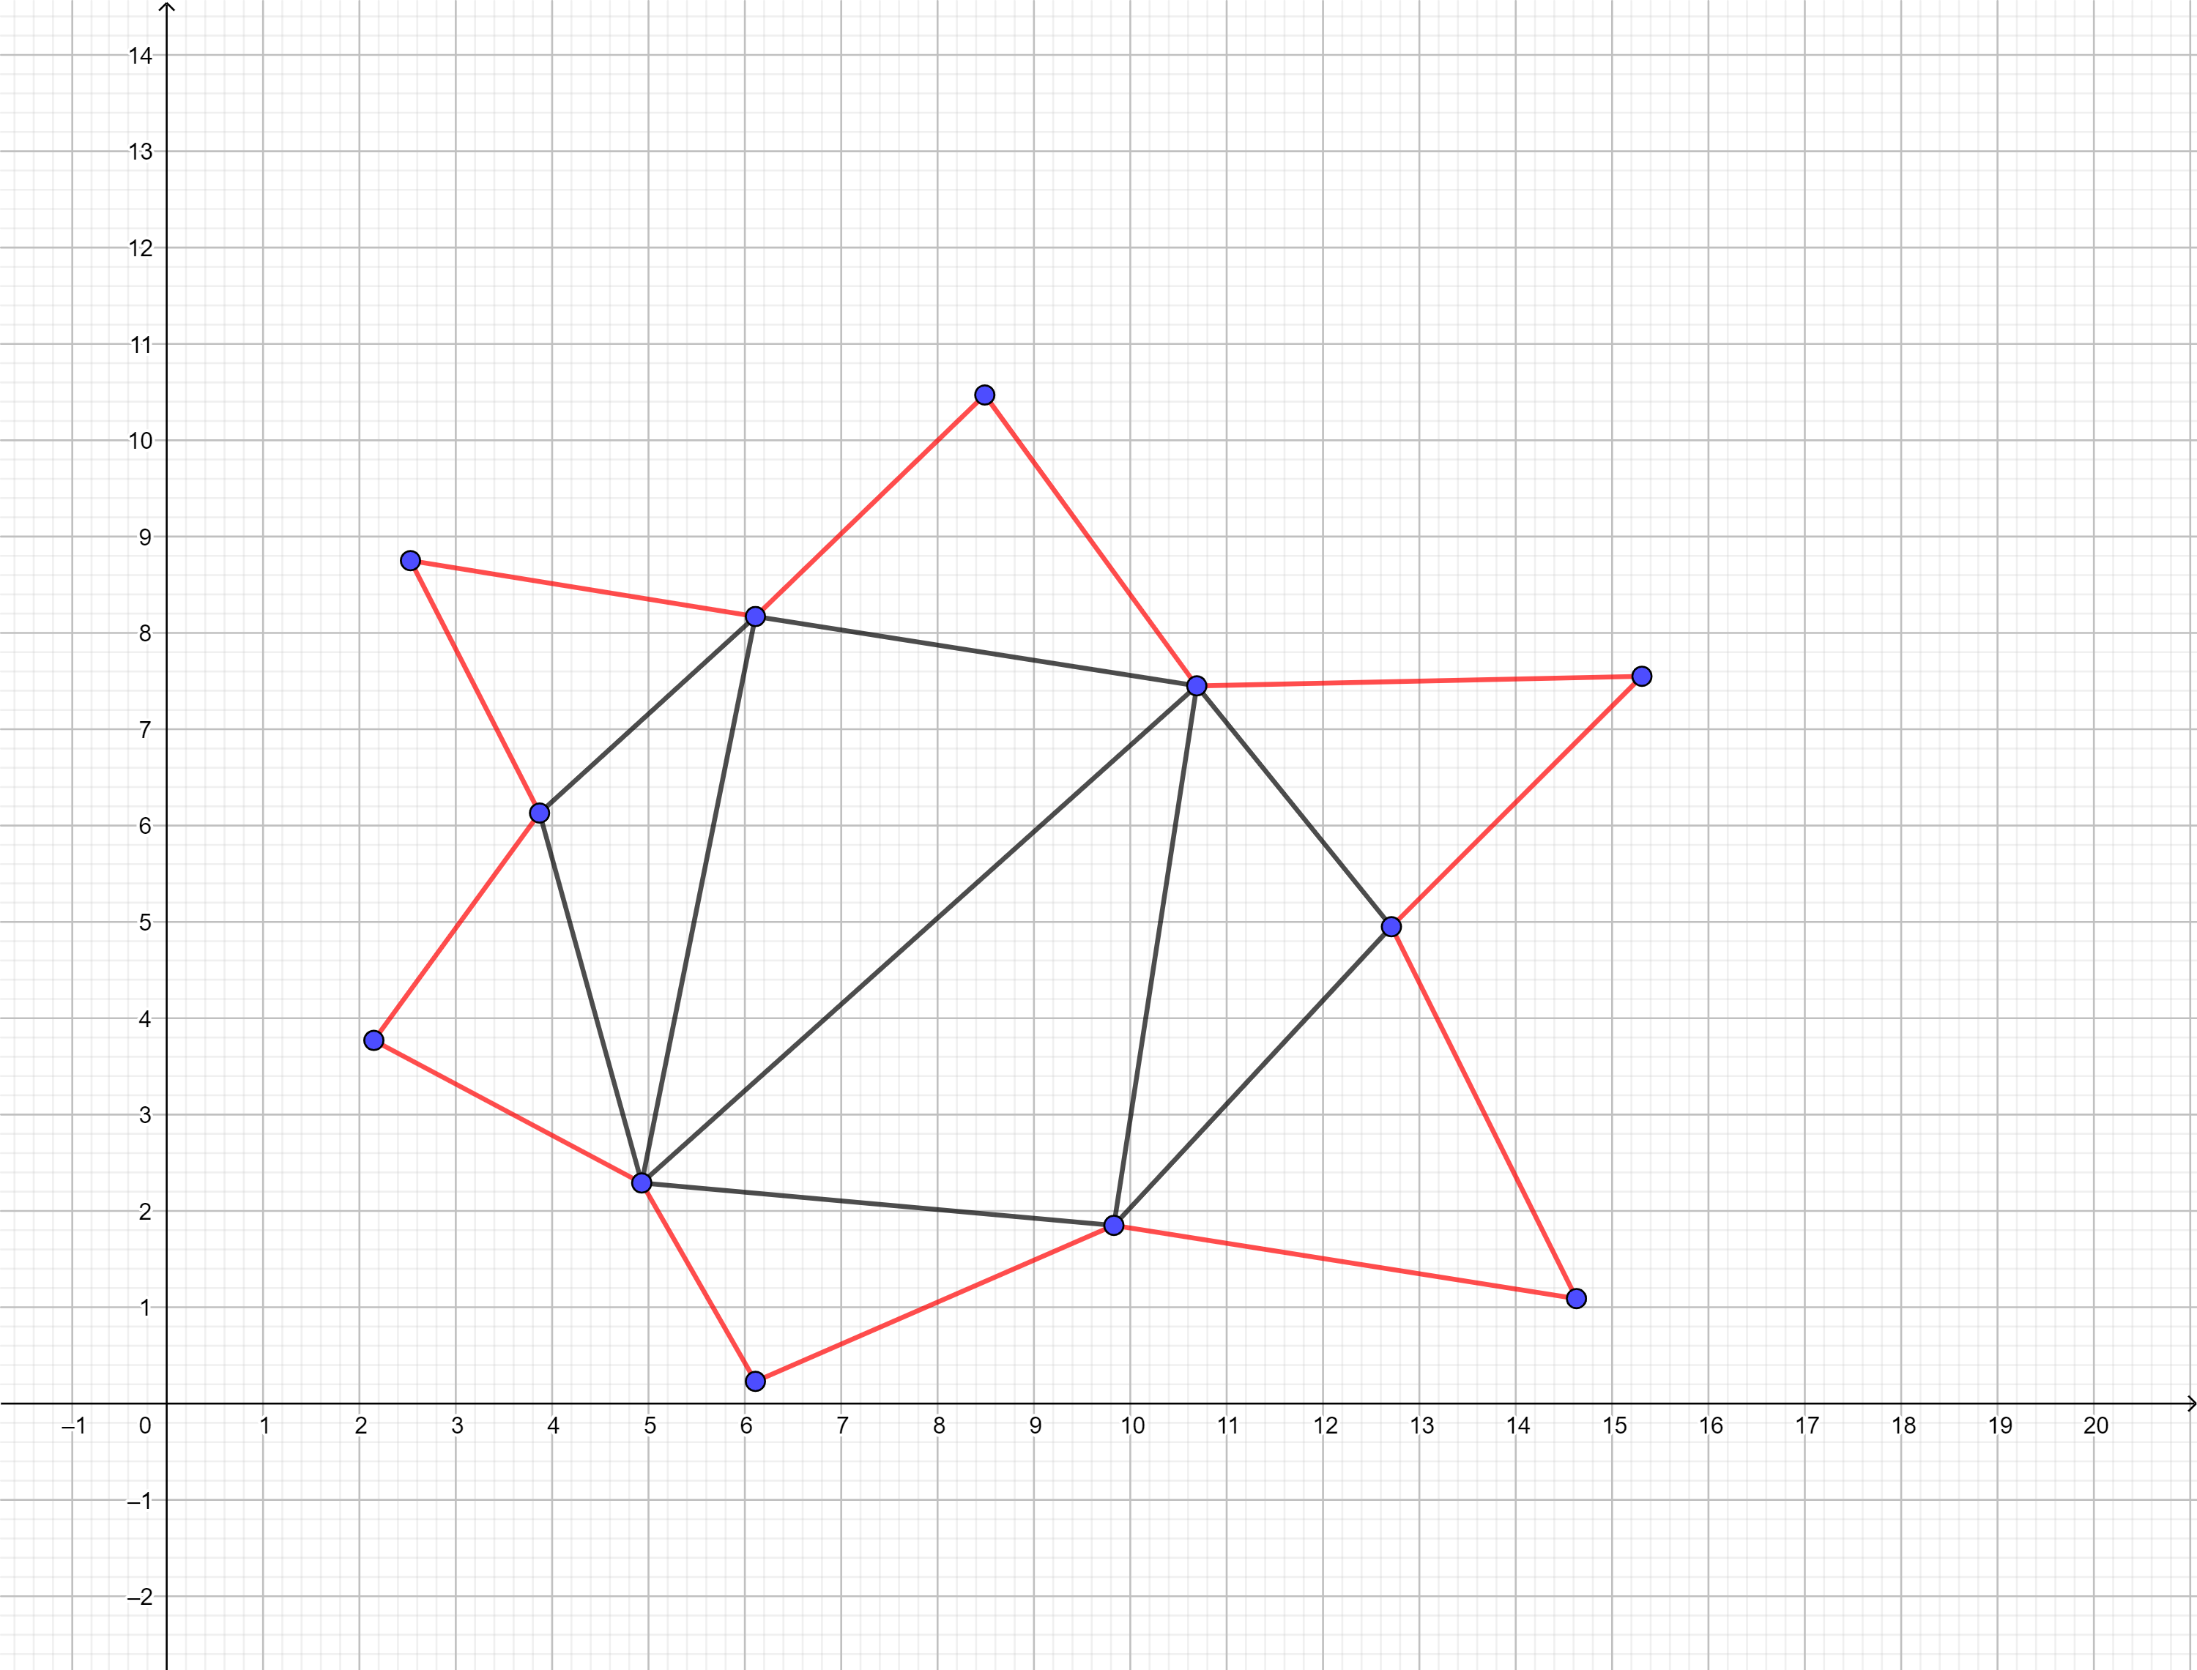
No “holes”
“Holes”: 中間出現不是三角形的圖形，i.e. 圖形中間出現boundary。

Slide 8
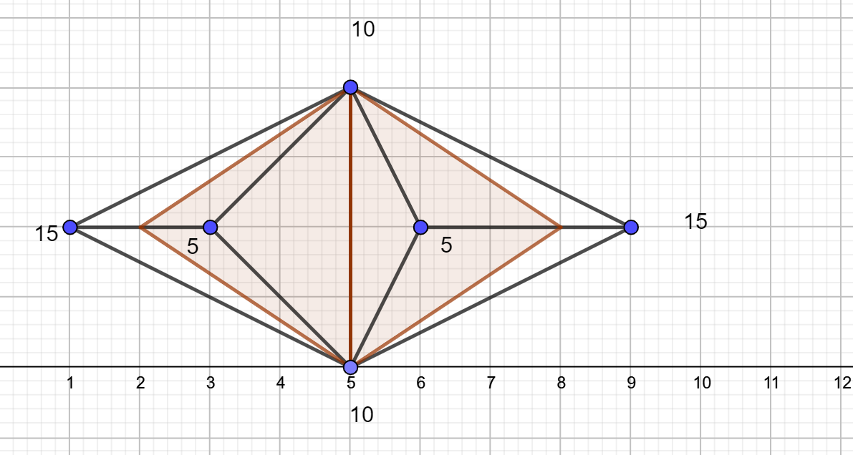
Zero depth
Two lakes connected with zero depth are considered separate lakes

Slide 9
Problem size
Num of nodes (V): Each node is given a distinct 2-letter code.
So V <= 52*53 <= 2756 ~=10³
3 <= V <= 2756~= 10³
Num of edges (E): Since there are no intersections, we know that num of edges is smaller than C(n,2) ~= 10⁶
3 <= E <= C(n,2) ~= 10⁶
x,y:
-10000<=x,y<=10000
h:
0<=h<=8848

Slide 10
Solution:暴力法O(VE)+find boundary
找出boundary???

Slide 11
流程
1.找出所有non-boundary node。 ＊O(?)
2.先對所有non-boundary node進行一次sorting。 O(V*lgV*)
3.由大到小對所有node(v_{i})做以下動作:(概念:尋找以v_{i}為中心點的湖)
(a)如果v_{i}已被包含在一個湖中則跳過此點，直接對下一個v_{i}進行3.。
(b)首先建一個包含v_{i}的disjoint set present_Lake:{v_{i}}
(d)對所有v_{i}的相鄰node(u_{j})做以下動作:
if v_{i}.height >=u_{j}.height, then union(v_{i},u_{j})(如果u_{j}為boundary node，直接退出，因為 boundary不可能在湖中)
if v_{i}.height <u_{j}.height, record the local min u_{j}.height.
對新的disjoint set recursively做(c)~(d)。
直到沒有node滿足(d)的if。
(e)The min we recorded in (d) is a dept of a lake. 將disjoint set present_Lake 中的所有node mark為湖中點。(為了之後不要重複找)
*每次最多就是找所有edge O(E)。對所有non-boundary node做:V**O(E) = O(V*E)
Note:V* is the number of non-boundary nodes

Slide 12
證明3. (e)
Recall that our graph has no “holes”, meaning that it is surrounded by boundaries.
And that our graph is a single connected region.
With the above stated, we can say that all our non-boundary nodes is “inside” the boundaries.
If the disjoint set Present_Lake doesn’t include any boundary nodes, it is at least inside the boundaries.
All neighbors of Present_Lake is higher than Present_Lake and Present_Lake is inside its neighbors -> Present_Lake can be a lake whose height is the lowest of its neighbors.

